Slide 1
Building Control Algorithms for State Space Search
하 진 영
강원대학교 컴퓨터공학과

Slide 2
Introduction
Definitions characterizing the data and control structures used to implement state space search
  1. Representation of a problem solution as a path from a start state to a goal.
  2. Search to test systematically alternative paths to a goal.
  3. Backtracking to allow an algorithm to “recover” from paths that fail to lead to a goal.
  4. Lists to keep explicit records of states under consideration.
    a. The open list allows the algorithm to backtrack to untried states if necessary.
    b. The closed list of visited states allows the algorithm to implement loop detection and avoid repeating fruitless paths.
  5. Use of a stack to implement depth-first search, a queue to implement breadth-first search, and a priority queue to implement best-first search.

Slide 3
Introduction (2)
Higher-level techniques for implementing search algorithms
  recursive search
    implements depth-first search with backtracking in a more concise, natural fashion
    forms the basis for many of the algorithms
  pattern-directed search
    augmented through the use of unification to search the state space generated by predicate calculus assertions
    basis of PROLOG and many of the expert systems and other AI applications

Slide 4
Introduction (3)
  production systems
    a general architecture for pattern-directed problem solving
  predicate calculus and pattern matching
    used in robot planning or problem solving across time periods
  the blackboard
    another AI problem-solving technique

Slide 5
Recursion-Based Search
Recursion
  in mathematics
    a recursive definition uses the term being defined as part of its own definition
  in computer science
    recursion is used to define and analyze both data structures and procedures
    recursive procedure
      a recursive step in which the procedure calls itself to repeat a sequence of actions
      a terminating condition that stops the procedure from recurring endlessly

Slide 6
Recursion
Recursion for data structure
  natural control structure
  no definite size, such as lists, trees, and graphs
  appropriate for state space search
A simple example of recursion
  an algorithm for determining if an item is a member of a list

Slide 7
A Procedure for Testing a Member of a List
function member (item, list);
begin
if list is empty
then return (fail) % terminate
else
if item = first element of list
then return (success) % terminate
else
begin
tail := list with its first item removed;
member (item, tail) % recur
end
end.

Slide 8
Recursive Search
function depthsearch; % open & closed global
begin
if open is empty
then return FAIL;
current_state := the first element of open;
if current_state is a goal state
then return SUCCESS;
else
begin
open := the tail of open;
closed := closed with current_state added;
for each child of current_state
if not on closed or open % build stack
then add the child to the front of open
end;
depthsearch % recur
end.

Slide 9
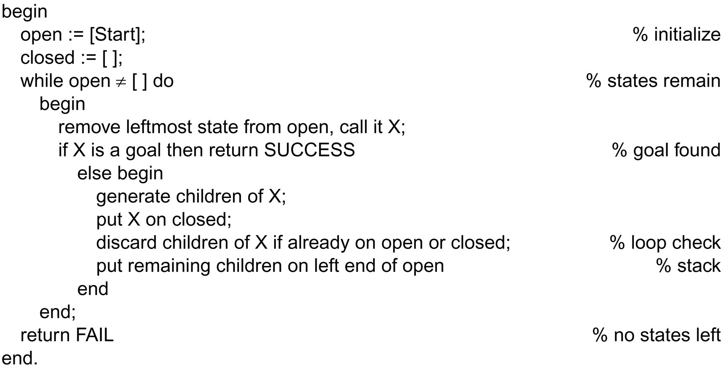
function depthsearch;
begin
if open is empty
then return FAIL;
current_state := the first element of open;
if current_state is a goal state
then return SUCCESS;
else
begin
open := the tail of open;
closed := closed with current_state added;
for each child of current_state
if not on closed or open
then add the child to the front of open
end;
depthsearch
end.
function depth_first_search in chap3

Slide 10
Recursive Search (2)
Breadth-first search
  can be implemented with the same algorithm, simply by implementing open as a queue rather than a stack
The implementation of depth-first search
  does not utilize the full power of recursion
  possible to simplify further by using recursion itself (rather than an explicit open list)
  closed is still maintained as a global variable

Slide 11
Recursive Search (3)
function depthsearch (current_state); % closed is global
begin
if current_state is a goal state
then return SUCCESS;
add current_state to closed;
while current_state has unexamined children
begin
child := next unexamined child;
if child not member of closed
then if depthsearch (child) = SUCCESS
then return SUCCESS
end;
return FAIL % search exhausted
end.

Slide 12
Recursive Search Example:
Pattern-Driven Reasoning
Application of recursive search to a space of logical inferences
  a general search procedure for predicate calculus
Goal-directed search
  e.g. we want to write an algorithm that determines whether a predicate calculus expression is a logical consequence of some set of assertion
    the algorithm must find a sequence of inferences that produce the goal expression
  initial query → forming the goals
  modus ponens → the transitions between states

Slide 13
Goal-Directed Search
Given a goal, the algorithm uses unification to select the implications whose conclusions match the goal
  e.g. goal: p(a), implication: q(X) → p(X).
  subgoal
    after unifying the goal with the conclusions of the implication (or rule) and applying the resulting substitutions throughout the rule, the rule premise becomes a new goal (q(a)) → subgoal
Then the algorithm recurs on the subgoal
  if a subgoal matches a fact in the knowledge base, search terminates
The series of inferences that led from the initial goal to the given facts prove the truth of the original goal

Slide 14
function pattern_search (current_goal);
begin
if current_goal is a member of closed % test for loops
then return FAIL
else add current_goal to closed;
while there remain in data base unifying facts or rules do
begin
case
current_goal unifies with a fact:
return SUCCESS;
current_goal is a conjunction (p∧…):
begin
for each conjunct do
call pattern_search on conjunct;
if pattern_search succeeds for all conjuncts
then return SUCCESS
else return FAIL
end;
current_goal unifies with rule conclusion (p in q→p):
begin
apply goal unifying substitutions to premise (q);
call pattern_search on premise;
if pattern_search succeeds
then return SUCCESS
else return FAIL
end;
end; % end case
return FAIL
end.

Slide 15
Pattern Search
The major advantage of using general methods such as unification and modus ponens
  the resulting algorithm may search any space of logical inferences
  the specifics of a problem are described using predicate calculus assertions
  ⇒ we have a means of separating
    problem-solving knowledge from
    its control and implementation on the computer

Slide 16
Problems of pattern_search
The order of matching
  simplest way to define an order
    to require the algorithm try rules and facts in the order in the knowledge base
Proper handling of logical operators (∧, ∨, and ¬)
  e.g. “p←q∧r” or “p ← q∨(r ∧s)”

Slide 17
Problems of pattern_search(2)
Conjuncts (∧)
  both expressions must be shown to be true
  must be solved with consistent variable bindings
Disjuncts (∨)
  either expression must be found to be true
Logical negations (¬)
  pattern_search handles negated goals by first solving the operand of the ¬
    if this subgoal succeeds, then return fail, else return success
Finally,
  the algorithm should not return success but should return the bindings involved in the solution

Slide 18
function pattern_search(current_goal);
begin
if current_goal is a member of closed % test for loops
then return FAIL
else add current_goal to closed;
while there remain unifying facts or rules do
begin
case
current_goal unifies with a fact: return unifying substitutions;
current_goal is negated (¬p):
begin
call pattern_search on p;
if pattern_search returns FAIL
then return{}; % negation is true
else return FAIL;
end;
current_goal is conjunction (p∧…):
begin
for each conjunct do
begin
call pattern_search on conjunct;
if pattern_search returns FAIL
then return FAIL;
else apply substitutions to other conjuncts;
end;
if pattern_search returns SUCCESS for all conjuncts
then return composition of unifications;
else return FAIL;
end;

Slide 19
current_goal is a disjunction (p∨…):
begin
repeat for each disjunct
call pattern_search on disjunct
until no more disjuncts or SUCCESS;
if pattern_search returns SUCCESS
then return substitutions
else return FAIL;
end;
current_goal unifies with rule conclusion (p in p←q):
begin
apply goal unifying substitutions to premise (q);
call pattern_search on premise;
if pattern_search succeeds
then return composition of p and q substitutions
else return FAIL;
end;
end; % end case
end % end while
return FAIL
end.

Slide 20
Complete Version of pattern_search
The algorithm
  basis of PROLOG and many goal-directed expert system shells
Production system
  an alternative control structure for pattern-directed search

Slide 21
Production Systems
Model of search and human problem solving
Heavily used in AI (Expert) system
Production system components
  production rules (or productions)
    also called long-term memory
  working memory
    also called short-term memory
  recognize-act cycle
    also called control structure, engine

Slide 22
Production Systems (2)
Definition
  A production system is defined by:
    1. The set of production rules.
      simply called productions
      condition-action pair
    2. Working memory contains a description of the current state of the world in a reasoning process.
    3. The recognize-act cycle.
  Conflict resolution chooses a rule from the conflict set (a subset of the productions) for firing
  The pure production system model
    has no mechanism for recovering from dead ends
    many practical implementations allow backtracking

Slide 23
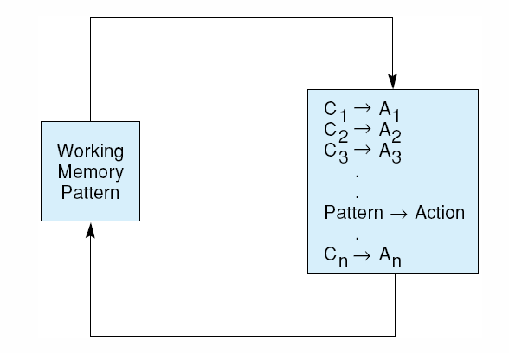
Schematic Drawing of a Production System
Fig 6.1 A production system. Control loops until working memory pattern no longer matches the conditions of any productions.

Slide 24
Production Rules
Production
  condition part and action part
  premise and conclusion
  LHS and RHS
Condition part - pattern matching
Action part - problem solving step
Single chunk of knowledge
Good for representing judgemental knowledge

Slide 25
Working Memory
Description of current state of world
Description will be matched against condition part of production to select problem solving action
Modified by problem solving action

Slide 26
Recognize-Act Cycle
Inference engine
Data in WM is matched against condition part of every production rules
Collect all matching productions as conflict set
Subset of conflict set is selected (by conflict resolution) and the selected productions are fired
Action of the fired production may modify WM

Slide 27
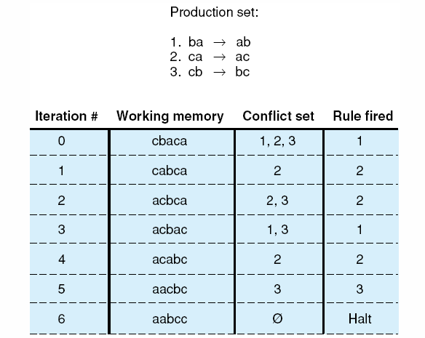
Simple Example of
Production System Execution
Fig 6.2 Trace of a simple production system.

Slide 28
Implementations
OPS5 by Carnegie Mellon
  originally written in LISP
  most popular production system
  forward chaining system
CLIPS by
  C version of OPS5
  most portable (available in PC)
JESS by Sandia National Laboratoties
  implemented in Java

Slide 29
Examples of Production Systems
8-Puzzle, revisited
  both complex enough to be interesting and small enough to be tractable ➔ frequently used to explore different search strategies
  legal moves are defined by the productions in Figure 6.3
  If a beginning state and a goal state are specified, it is possible to make a production system accounting of the problem’s search space.
  A depth bound of 5 is used in the solution of Figure 6.4.
    number of possible states of working memory grows exponentially with the depth of the search

Slide 30
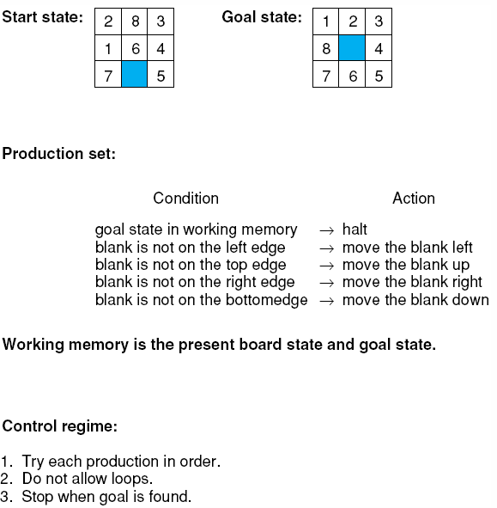
Fig 6.3 The 8-puzzle as a production system.

Slide 31
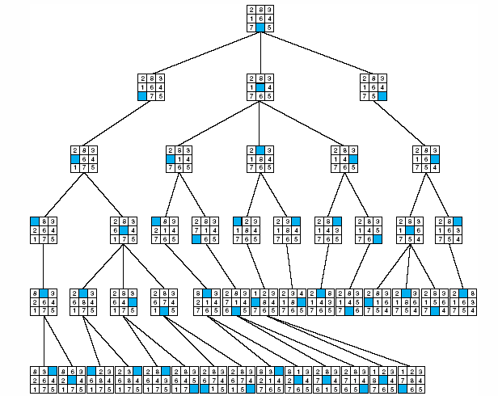
Fig 6.4 The 8-puzzle searched by a production system with loop detection and depth-bound , from Nilsson (1971).

Slide 32
Examples of Production Systems (2)
Knight Tour Problem
  Illustration of the use of predicate calculus with a general controller to solve search problems
  In the game of chess, a knight can move
    two squares either horizontally or vertically followed by one square in an orthogonal direction
    ⇒ at most 8 possible moves that the knight may make (see Fig. 6.5)

Slide 33
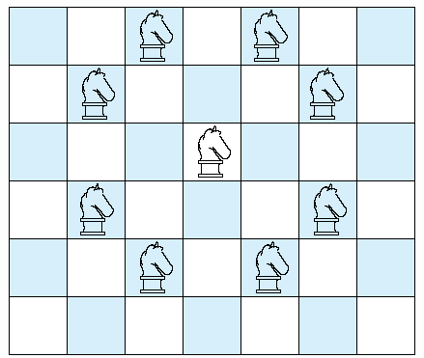
Fig 6.5 Legal moves of a chess knight.

Slide 34
Knight’s tour problem
  attempt to find a series of legal moves in which the knight lands on each square of the chessboard exactly once
  has been a mainstay in the development and presentation of search algorithms
Simplified version
  Is there a series of legal moves that will take the knight from one square to another on a reduced-size (3×3) chess board?

Slide 35
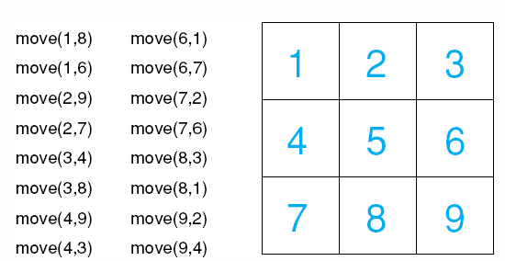
Fig 6.6 a 3 x 3 chessboard with move rules for the simplified knight tour problem.

Slide 36
Another request
  to find where the knight can move from a particular location such as square 2
    goal move(2, X) unifies with two different predicates in the knowledge base with substitutions of {7/X} and {9/X}
Next task
  to devise a general definition for a path of successive moves around the board
  done through predicate implication
    add rules to the knowledge base
    e.g. two-move path
      ∀X,Y [path2(X,Y)←∃Z[move(X,Z)∧move(Z,Y)]]

Slide 37
Three-move path
  ∀X,Y [path3(X,Y)←∃Z,W[move(X,Z)∧move(Z,W) ∧move(W,Y)]]
  ∀X,Y [path3(X,Y)←∃Z [move(X,Z)∧path2(Z,Y)]]
General recursive rule
  ∀X,Y [path(X,Y)←∃Z [move(X,Z)∧path(Z,Y)]]
    can be used to determine whether a path of any length exists
    may be stated as “to find a path from one square to another, first make a move from the starting square to an intermediate location and then find a path from the intermediate to the final square”

Slide 38
The general recursive rule
  incomplete in that it includes no terminating condition
  should add path(X,X) to the knowledge base
The recursive formulation
  when combined with the recursive control provided by pattern_search, these rules will search the space of possible paths in the knight’s tour problem

Slide 39
Combined with the move rules
  move(1,8). move(1,6). move(2,9). move(2,7). move(3,4). move(3,8). move(4,9). move(4,3). move(6,1). move(6,7). move(7,2). move(7,6). move(8,3). move(8,1). move(9,2). move(9,4). ∀X path(X,X) ∀X,Y [path(X,Y)←∃Z [move(X,Z)∧path(Z,Y)]]
  complete problem description (or knowledge base)

Slide 40
Productions
  Rule# CONDITION ACTION
  1 knight on square 1 → move knight to square 8
  2 knight on square 1 → move knight to square 6
  3 knight on square 2 → move knight to square 9
  4 knight on square 2 → move knight to square 7
  5 knight on square 3 → move knight to square 4
  6 knight on square 3 → move knight to square 8
  7 knight on square 4 → move knight to square 9
  8 knight on square 4 → move knight to square 3
  9 knight on square 6 → move knight to square 1
  10 knight on square 6 → move knight to square 7
  11 knight on square 7 → move knight to square 2
  12 knight on square 7 → move knight to square 6
  13 knight on square 8 → move knight to square 3
  14 knight on square 8 → move knight to square 1
  15 knight on square 9 → move knight to square 2
  16 knight on square 9 → move knight to square 4

Slide 41
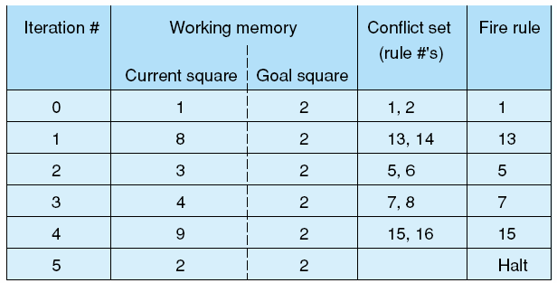
Fig 6.7 A production system solution to the 3 x 3 knight’s tour problem.

Slide 42
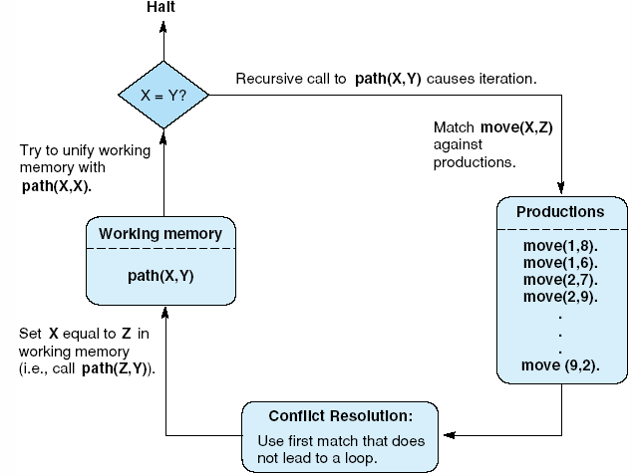
Fig 6.8 The recursive path algorithm as production system.

Slide 43
Control of Search in
Production System
Adding heuristic control to a search algorithm
  Control through Choice of Data-Driven or Goal-Driven Search Strategy
  Control of Search through Rule Structure
  Control of Search through Conflict Resolution

Slide 44
Control through Choice of
Data-Driven or Goal-Driven Search Strategy
Data-driven search
Goal-driven search
Combinations of strategies
  search in a forward direction until the number of states becomes large
  and then switch to a goal-directed search to use possible subgoals to select among alternative states

Slide 45
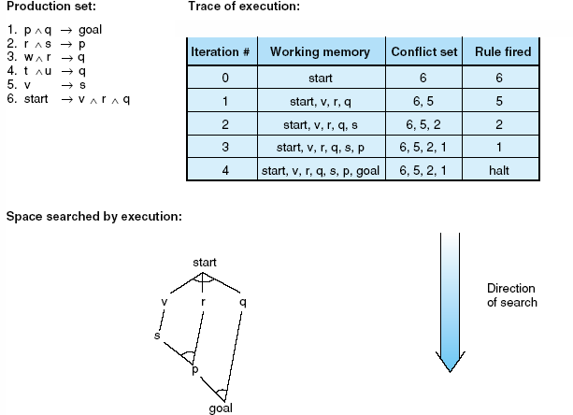
Fig 6.9 Data-driven search in a production system.

Slide 46
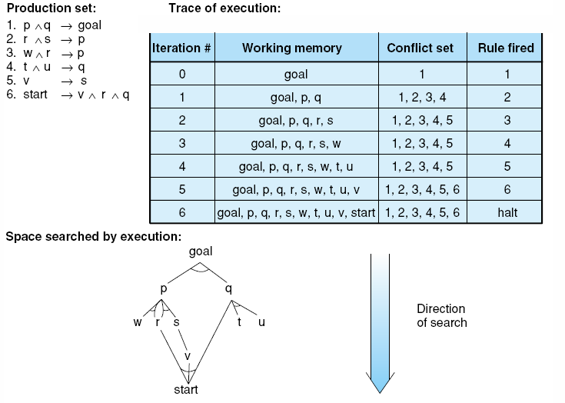
Fig 6.10 Goal-driven search in a production system.

Slide 47
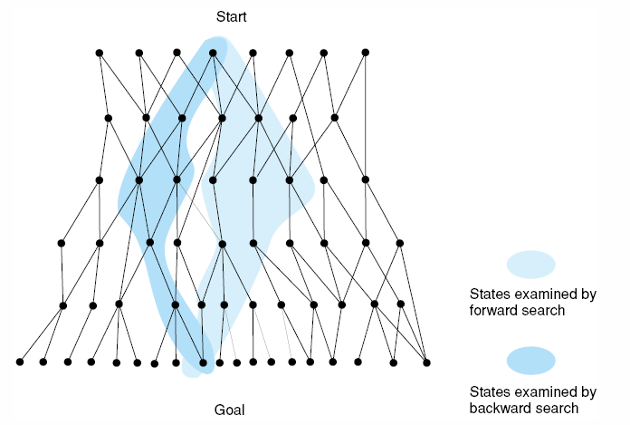
Fig 6.11 Bidirectional search missing in both directions, resulting in excessive search.

Slide 48
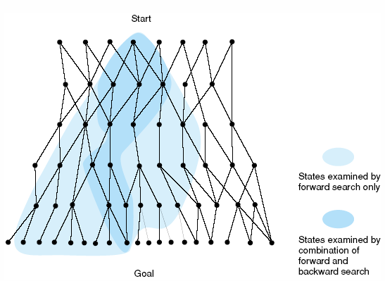
Fig 6.12 Bidirectional search meeting in the middle, eliminating much of the space examined by unidirectional search.

Slide 49
Control of Search through Rule Structure
Logically equivalent expressions
  ∀X (foo(X) ∧ goo(X) → moo(X)).
  ∀X (foo(X) → moo(X) ∨ ¬goo(X)).
    do not lead to the same results when interpreted as productions because the production system implementation imposes an order on the matching and firing of rules
Procedural semantics
  imposed by the production system
  programmer may control search through the structure and order of rules
    When a mechanics says, “If the engine won’t turn over and the lights don’t come on, then check the battery”

Slide 50
Control of Search through Conflict Resolution
Conflict resolution strategies supported by OPS5 include:
  1. Refraction
    specifies that once a rule has fired, it may not fire again until the working memory elements that match its conditions have been modified → discourages looping
  2. Recency
    prefers rules whose conditions match with the patterns most recently added to working memory → focuses the search on a single line of reasoning
  3. Specificity
    assumes that a more specific rule is preferable to a general rule → match fewer potential working memory patterns

Slide 51
Advantages of
Production Systems for AI
Separation of Knowledge and Control
A Natural Mapping onto State Space Search
Modularity of Production Rules
Pattern-Directed Control
Opportunities for Heuristic Control of Search
Tracing and Explanations
Language Independence
A Plausible Model of Human Problem Solving

Slide 52
Blackboard Architecture
Blackboards
  extend production system by allowing us to organize working memory into separate modules
    each of which corresponds to a different subset of the production rules
  allow us
    to integrate separate sets of production rules in a single agent or
    to coordinate the actions of multiple cooperating problem solvers in a single global structure

Slide 53
Blackboard Architecture (2)
Blackboard architecture
  a model of control that has been applied to the problems requiring the coordination of multiple processes or knowledge sources
  blackboard
    central global data base for communication of independent asynchronous knowledge sources
  each knowledge source
    gets its data from the blackboard, processes the data, and returns its results to the blackboard to be used by the other knowledge sources

Slide 54
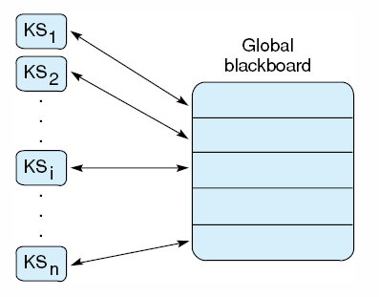
Blackboard Architecture (3)
Knowledge source
  independent
    separate process operating according to its own specifications
  asynchronous
    each KS_{i} begins its operation whenever it finds appropriate input data posted on the blackboard

Slide 55
HEARSAY-II
First introduced blackboard architecture for speech understanding
Levels of analysis of the utterances
  KS₁. The waveform of the acoustic signal.
  KS₂. The phonemes or possible sound segments
  KS₃. The syllables that the phonemes could produce
  KS₄. The possible words as analyzed by one KS
  KS₅. The possible words as analyzed by a second KS
  KS₆. A KS to generate possible word sequences.
  KS₇. A KS that puts word sequences into possible phrases.

Slide 56
HEARSAY-II (2)
Analysis of HEARSAY-II
  if a KS at one level cannot process the data sent to it, that KS can request the KS that sent it the data to go back for another try or to make another hypothesis about the data
  different KSs can be working on different parts of the utterance at the same time
  one of the KSs, called the scheduler, handles the “consume-data post-result” communication between the KSs

